Slide 1
Los Angeles Crime Statistics
Team Pipinstall
Data 228 Term Project Presentation

Slide 2
Problem and Motivation
According to the Public Policy Institute of California:
“California’s violent crime rate increased by 6.0%, from 440 per 100,000 residents in 2020 to 466 in 2021. While robberies fell somewhat (by 1.9%), aggravated assaults jumped by 8.9%, and homicides and rape increased by 7.7% and 7.9%, respectively.”
Using historical data on crime incidents:
Draw out insights and visualization
Query data
Statistics
Come up with data driven solutions to reduce or combat the rise of crime incidents

Slide 3
Goals and Objectives
Create web application
Users can develop insights and visualizations
Data drawn from historical crime data
Knowledge can be used for different application
Example:
Tourist wants to visit LA
Checks web application on areas with less crimes happening
Plans trip accordingly to avoid areas with a lot of crime
Safe trip

Slide 4
Application and Impact
Tourist:
Application:
Uses visualizations from web application to plan trip
Avoid areas with a lot of crime
Impact:
Safer trips promotes tourism
Tourism boosts nation’s economy

Slide 5
Application and Impact
Law Enforcement
Application:
Uses visualizations from web application to plan patrol areas
Patrol Areas with more crime
Can detect which department to allocate budget in based on which crime is on the rise right now.
Impact:
Increased patrols could reduce crimes happening in the area
Improve public safety and gain public trust

Slide 6
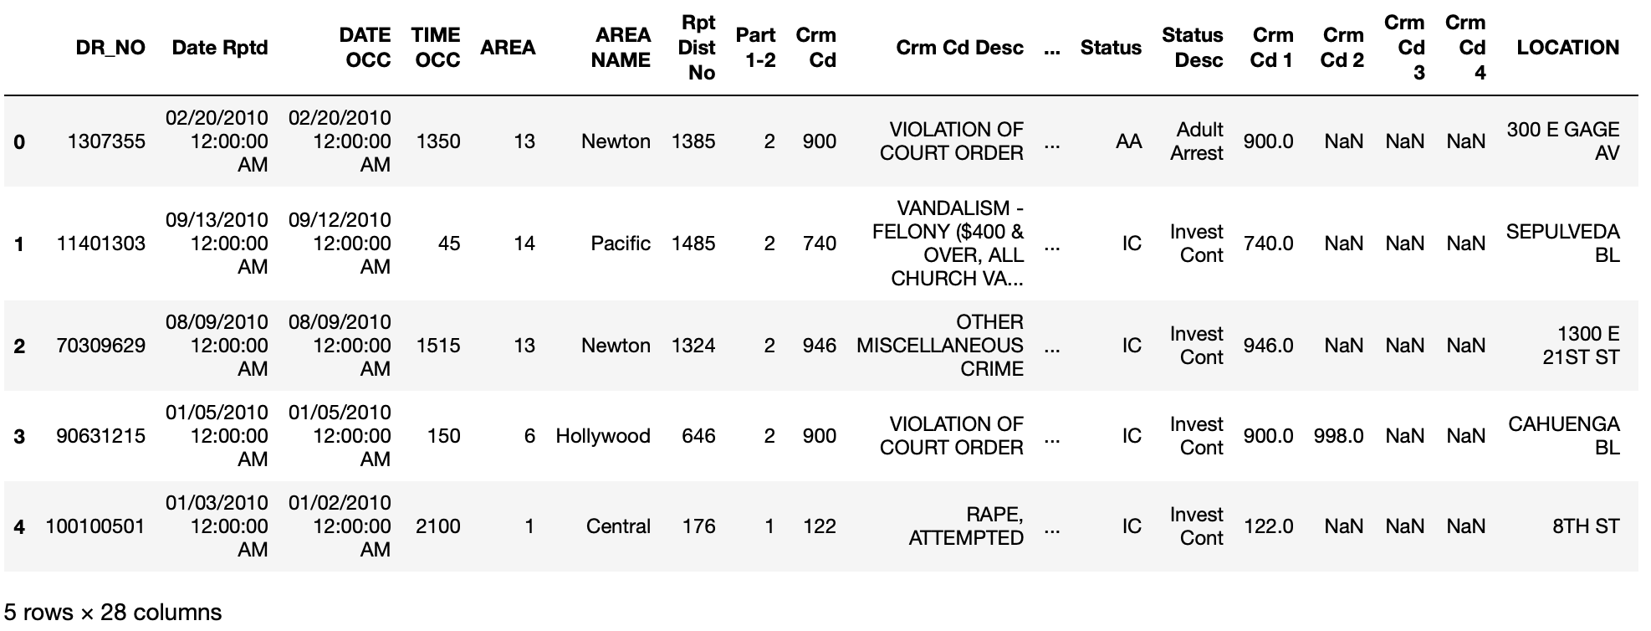
Project Dataset Source
Los Angeles Crime Data (2010 to 2023)
Contains crime incident records in the city of Los Angeles
Provided by the Los Angeles Police Department
Merged Crime Data (2010 - 2019 and 2020 - Present)
2.8 million rows with 28 columns

Slide 7
Background and Related Work
Bhat and Monica (2019) utilize Apache Pig to analyze a high number of crime data from the country of India.
Focus on crimes committed against girls and women from 2016 to 2019.
Hopes that their analysis and findings can aid policy makers and police departments in India to make communities safer.
Mukherjee et. al (2018) utilize Apache Pig to analyze crime data in Chicago from 2001 to 2018.
Analyze the numbers of certain crimes, and how they have changed throughout different time periods.
Provide insight into the times at which certain crimes have more commonly occurred (for instance theft related crimes most commonly occur between 12 pm and 1 pm).
Research provides valuable insights into crimes in Chicago.

Slide 8
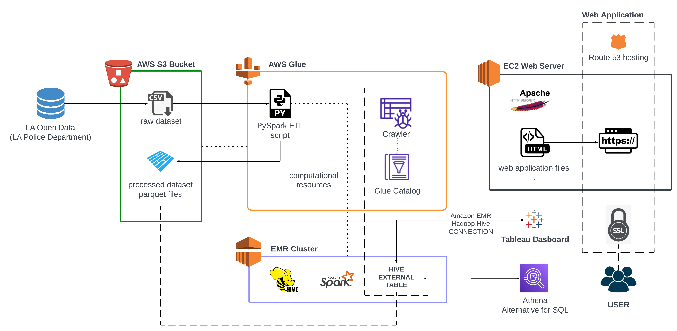
System Architecture

Slide 9
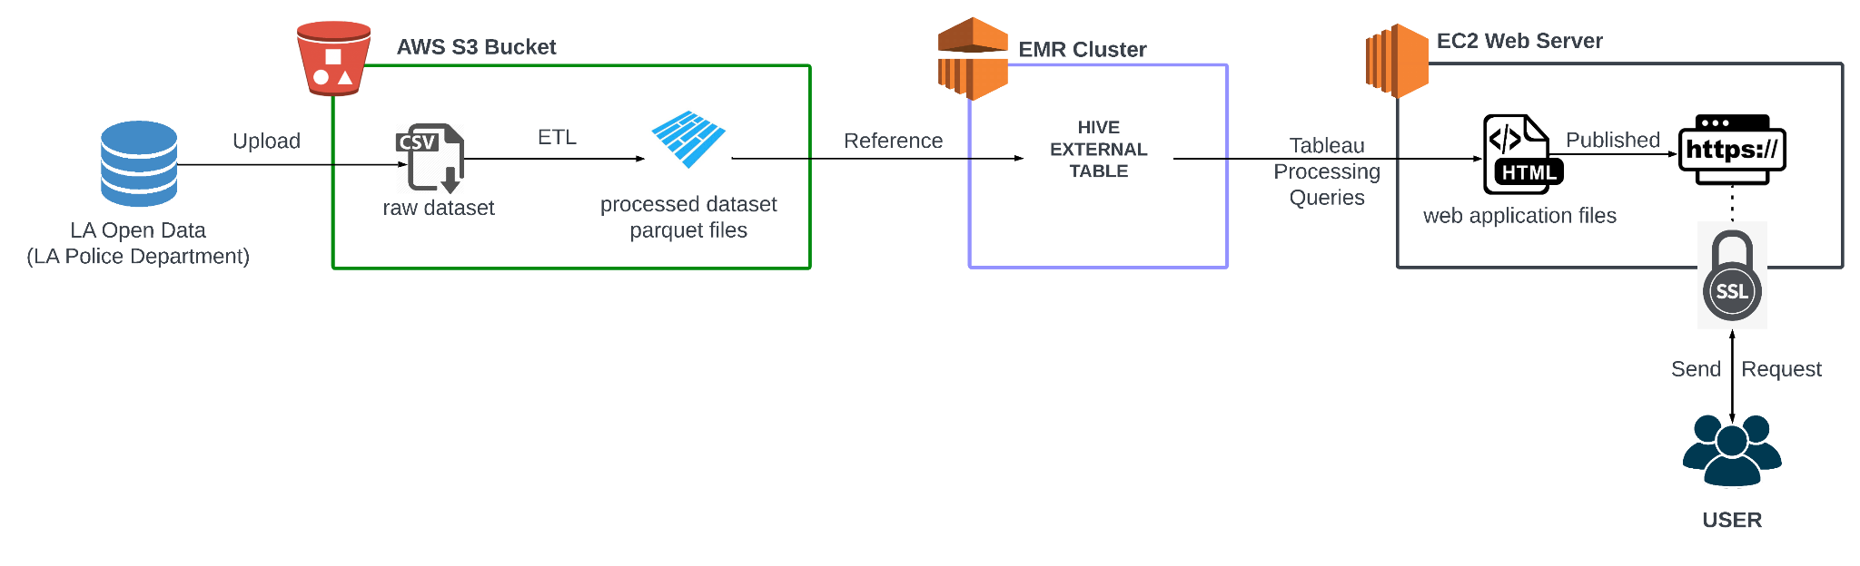
Data Flow Diagram

Slide 10
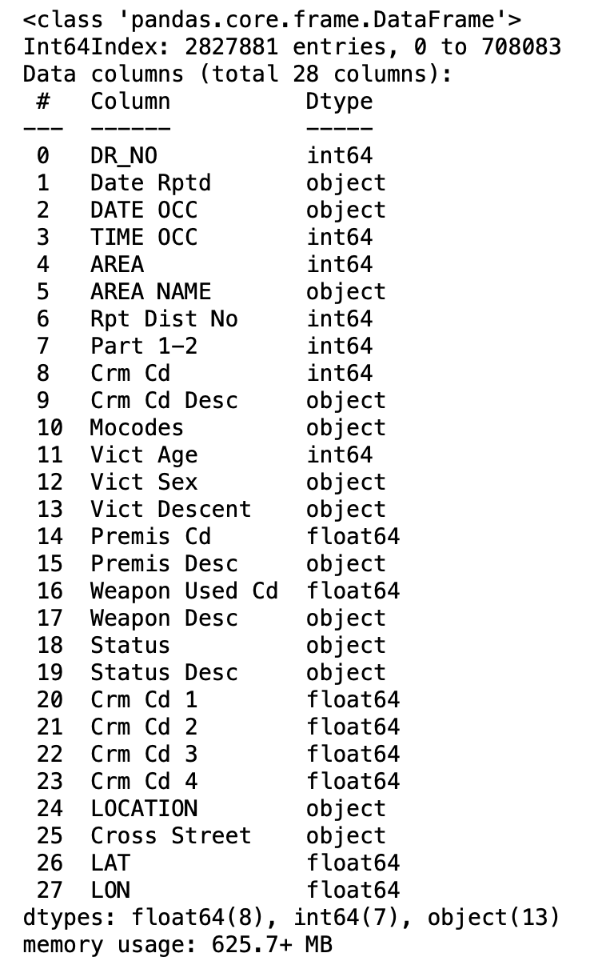
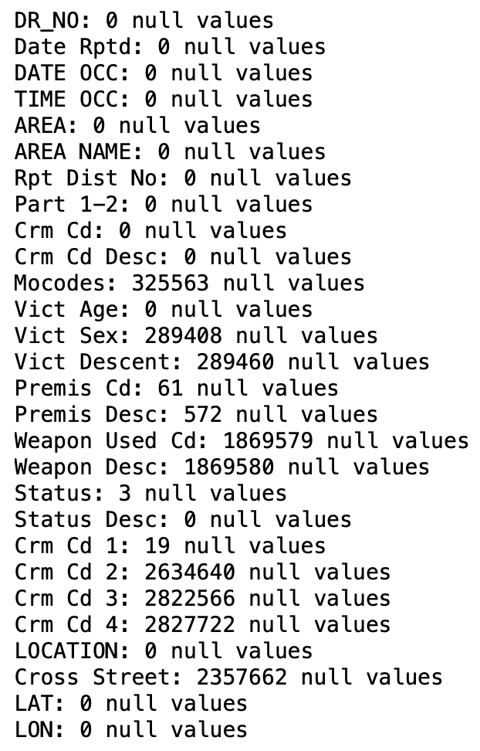
Data Cleaning
Process:
Drop irrelevant features
Data type conversion
Impute missing values
Drop duplicates

Slide 11
Data Cleaning
Dropping irrelevant columns/features:
DR_NO - Division of Records Number
Rpt Dist No - 4 digit code representing sub-area within a Geographic area.
Part 1-2 - No description
Mocodes - Modus Operandi Codes
Crm Cd 1, Crm Cd 2, Crm Cd 3, Crm Cd 4 - Crime Code Committed
Used for multiple crime code
Crm Cd and Crm Cd 1 are duplicates
Cross Street - Cross street of rounded address

Slide 12
Data Cleaning
Data type conversion:
Date Rptd - Date Type (removed 12:00:AM)
DATE OCC - Date Type (removed 12:00:AM)
TIME OCC - standard military time format (e.g. 1350 in the first row was transformed to 13:50, 45 in the next row was converted to 00:45)

Slide 13
Data Cleaning
Vict Age:
Check vict age distribution
Age → Continuous
Convert Ages: 0, -1, and -2 into NaN.
Vict Sex:
Check vict sex distribution
Documentation: Male (M), Female (F), Unknown (X)
Convert: H,N and - → X
Convert: Null values → N/A

Slide 14
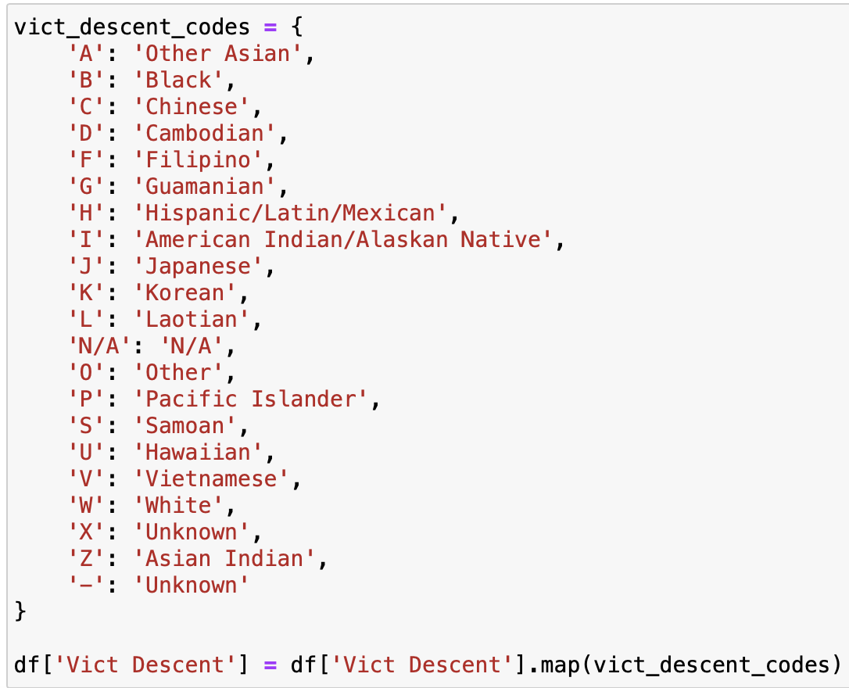
Vict descent
Null → N/A
Checked unique categories → Assigned 4 incorrect “-” to “Unknown”
Map → Convert the Vict descent column to spell out the descent instead of using codes with the use of a dictionary

Slide 15
Data Cleaning
Premis code
N/A → 0
Premis desc
If null → unknown

Slide 16
Data Cleaning
Weapon cd and desc
Find cd but null desc → did not match any →drop
Weapon desc null → N/A
Weapon cd null → 0

Slide 17
Data Cleaning
Status
Check the status counts for outliers
If status desc → UNK then
Status cd → CC

Slide 18
Latitude and longitude
Missing lat and long had 0 according to documentation. Removed a few records with 0 for latitude and longitude
Dropped duplicates
~2.8 million rows

Slide 19
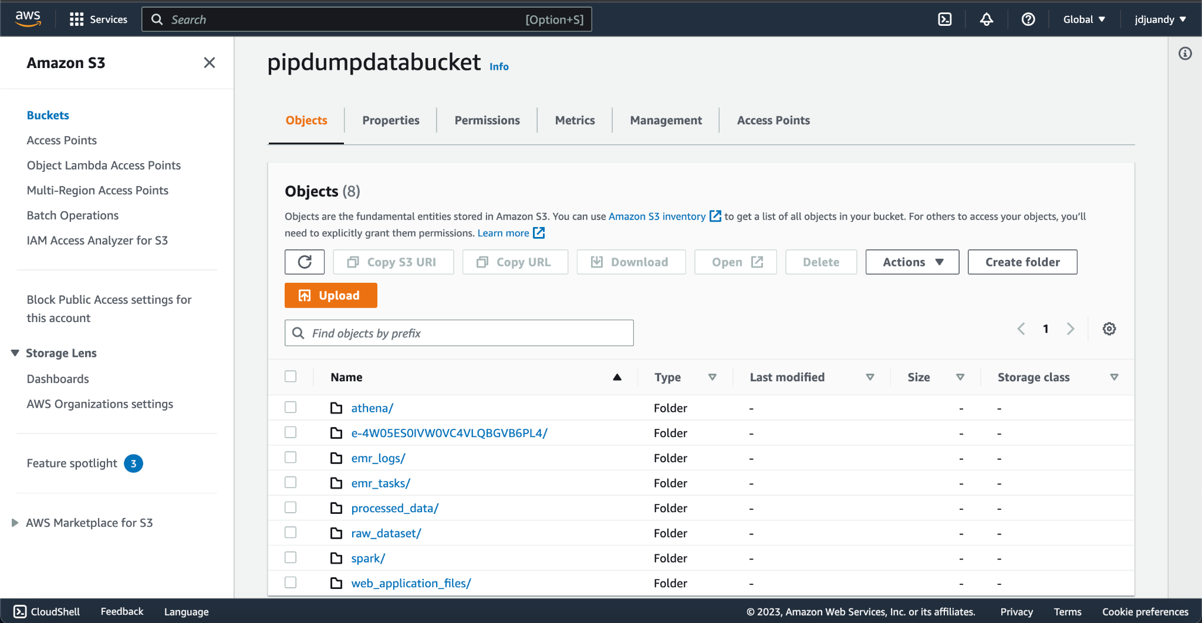
S3 bucket

Slide 20
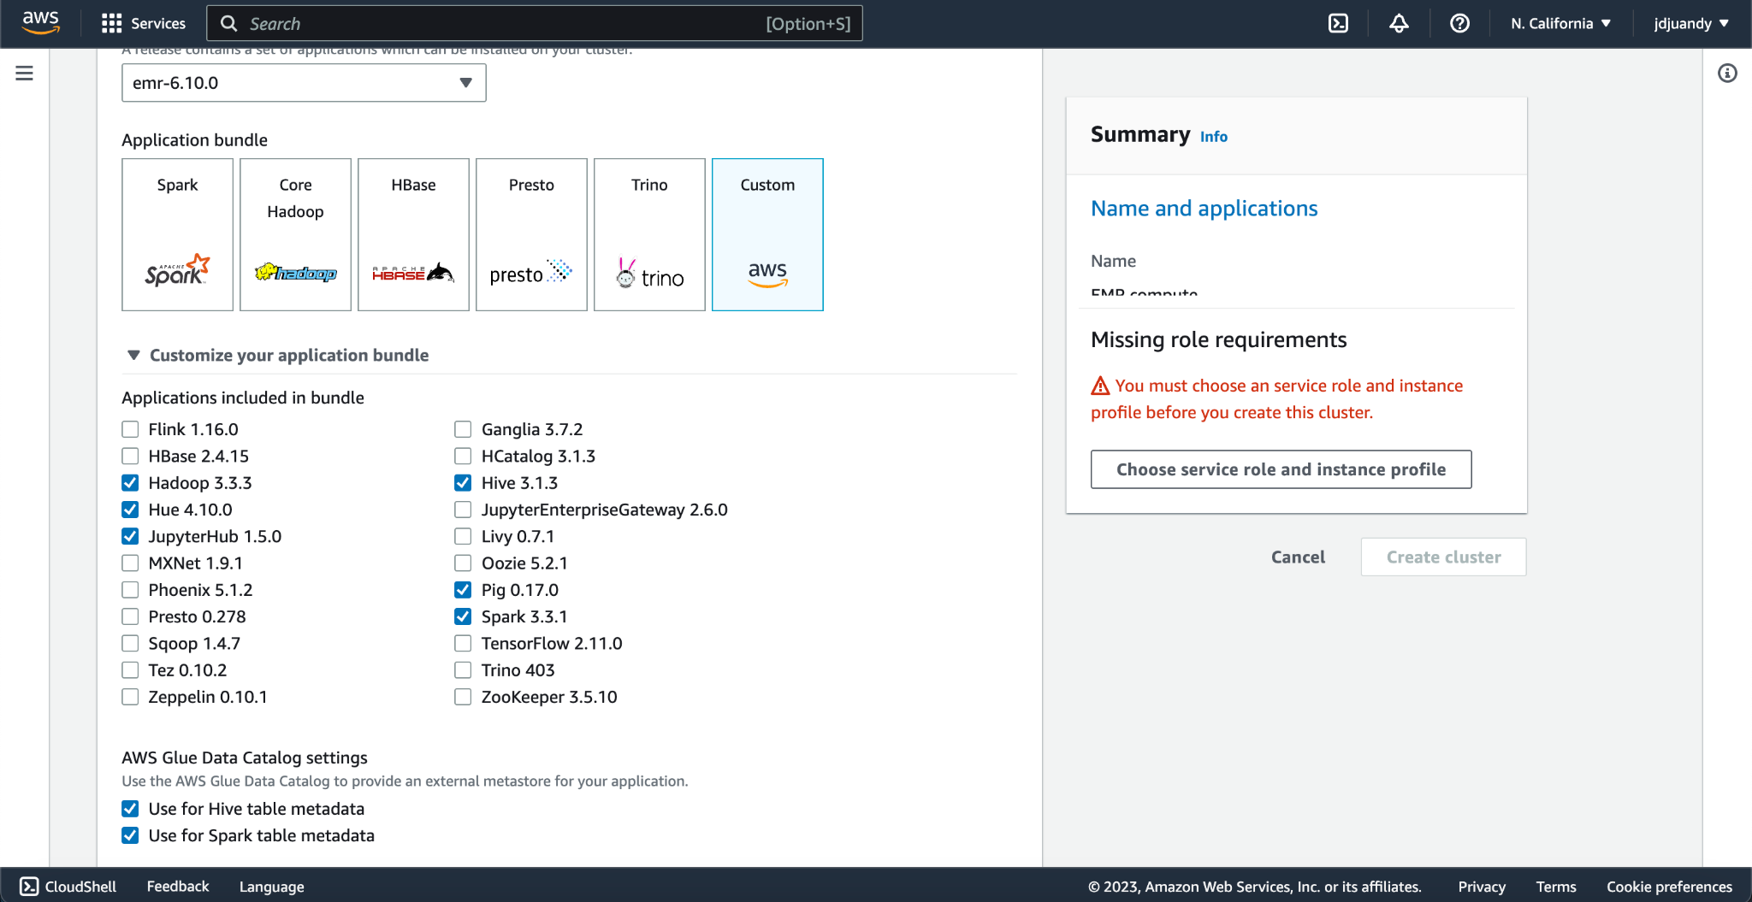
EMR cluster applications

Slide 21
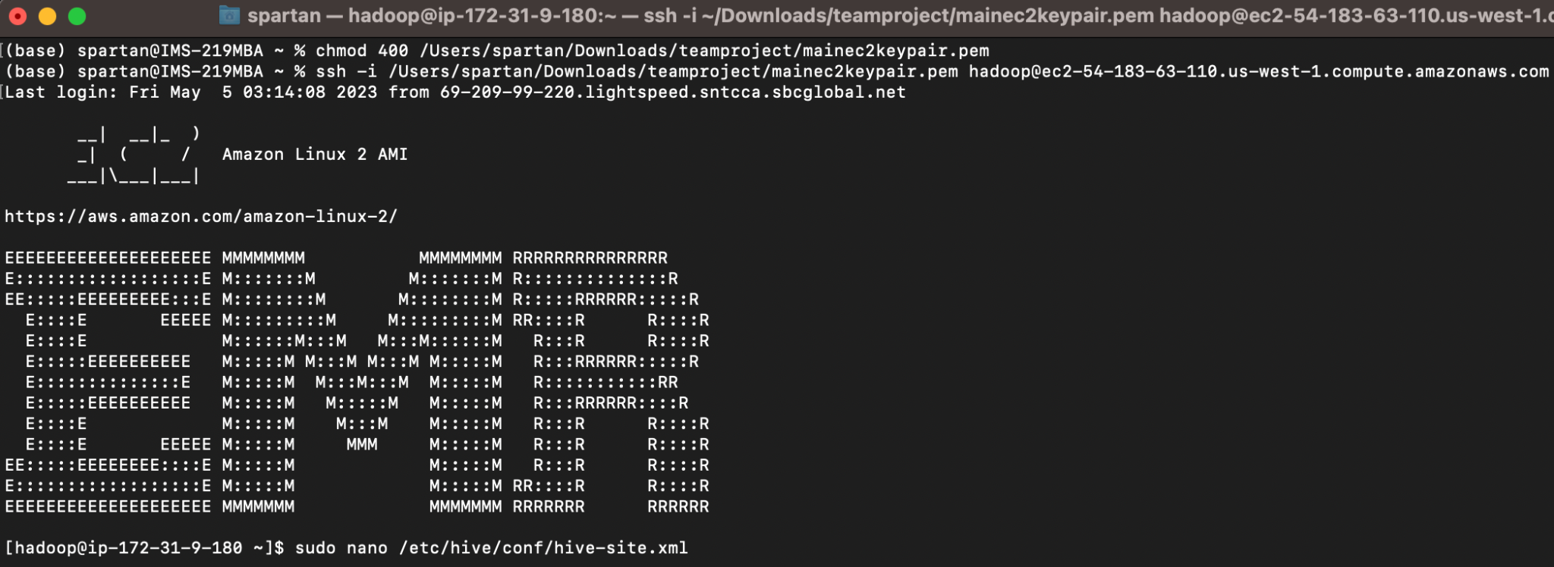
EMR CLI, Hive

Slide 22
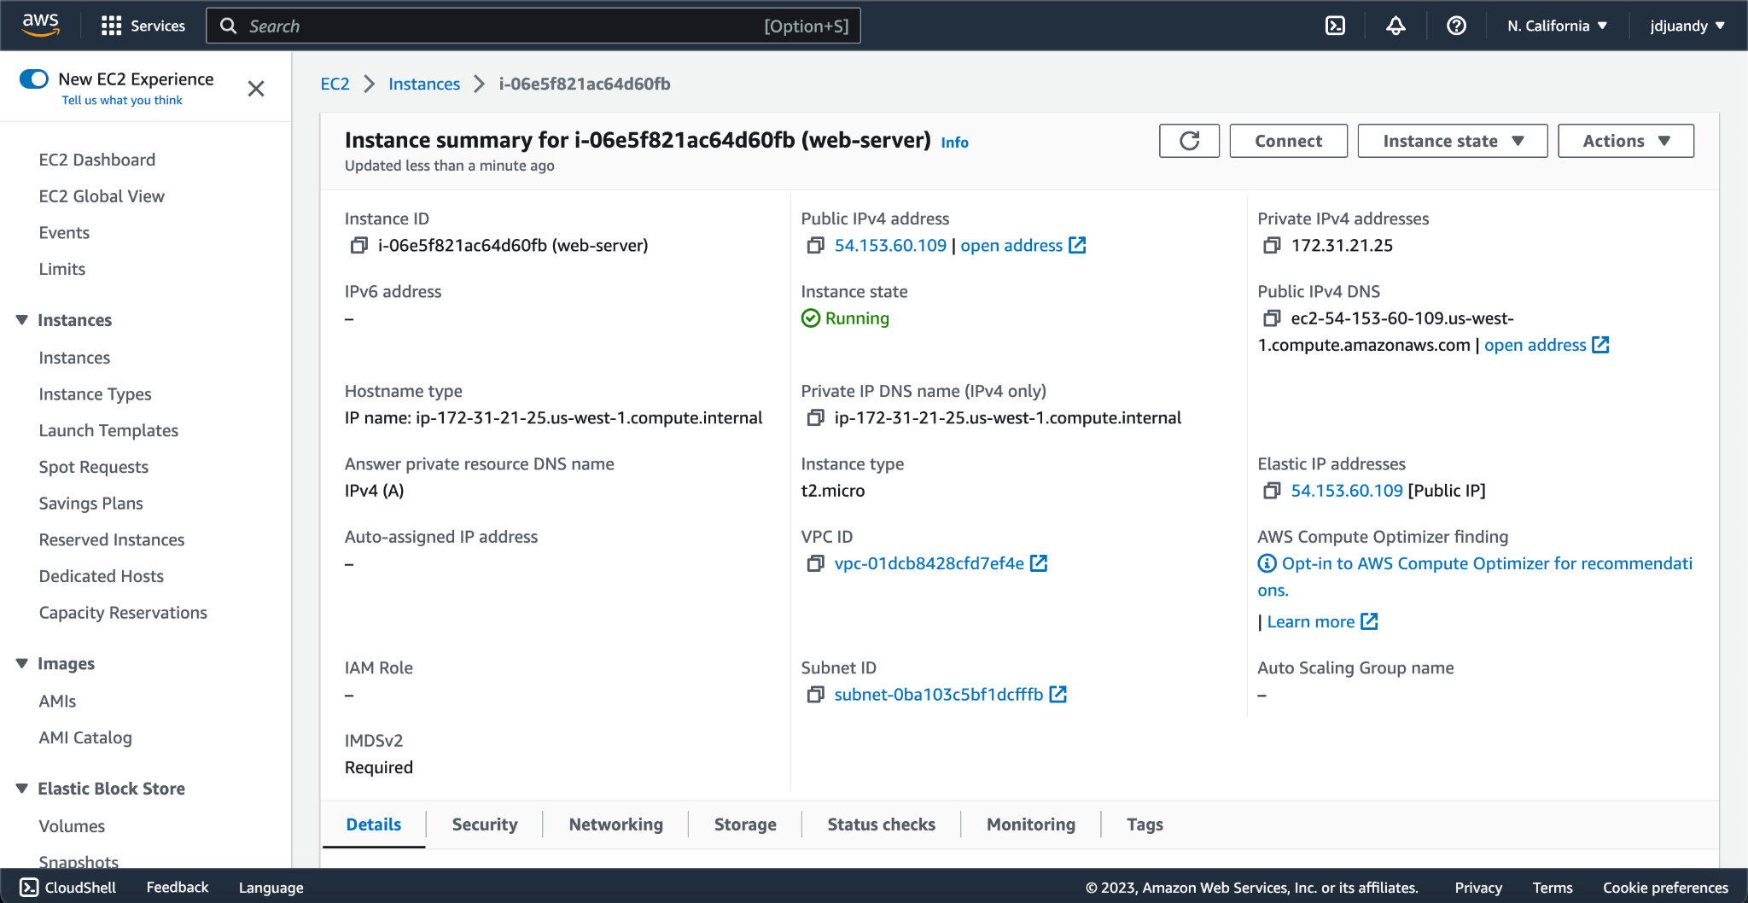
EC2 Web Server (Apache HTTP)

Slide 23
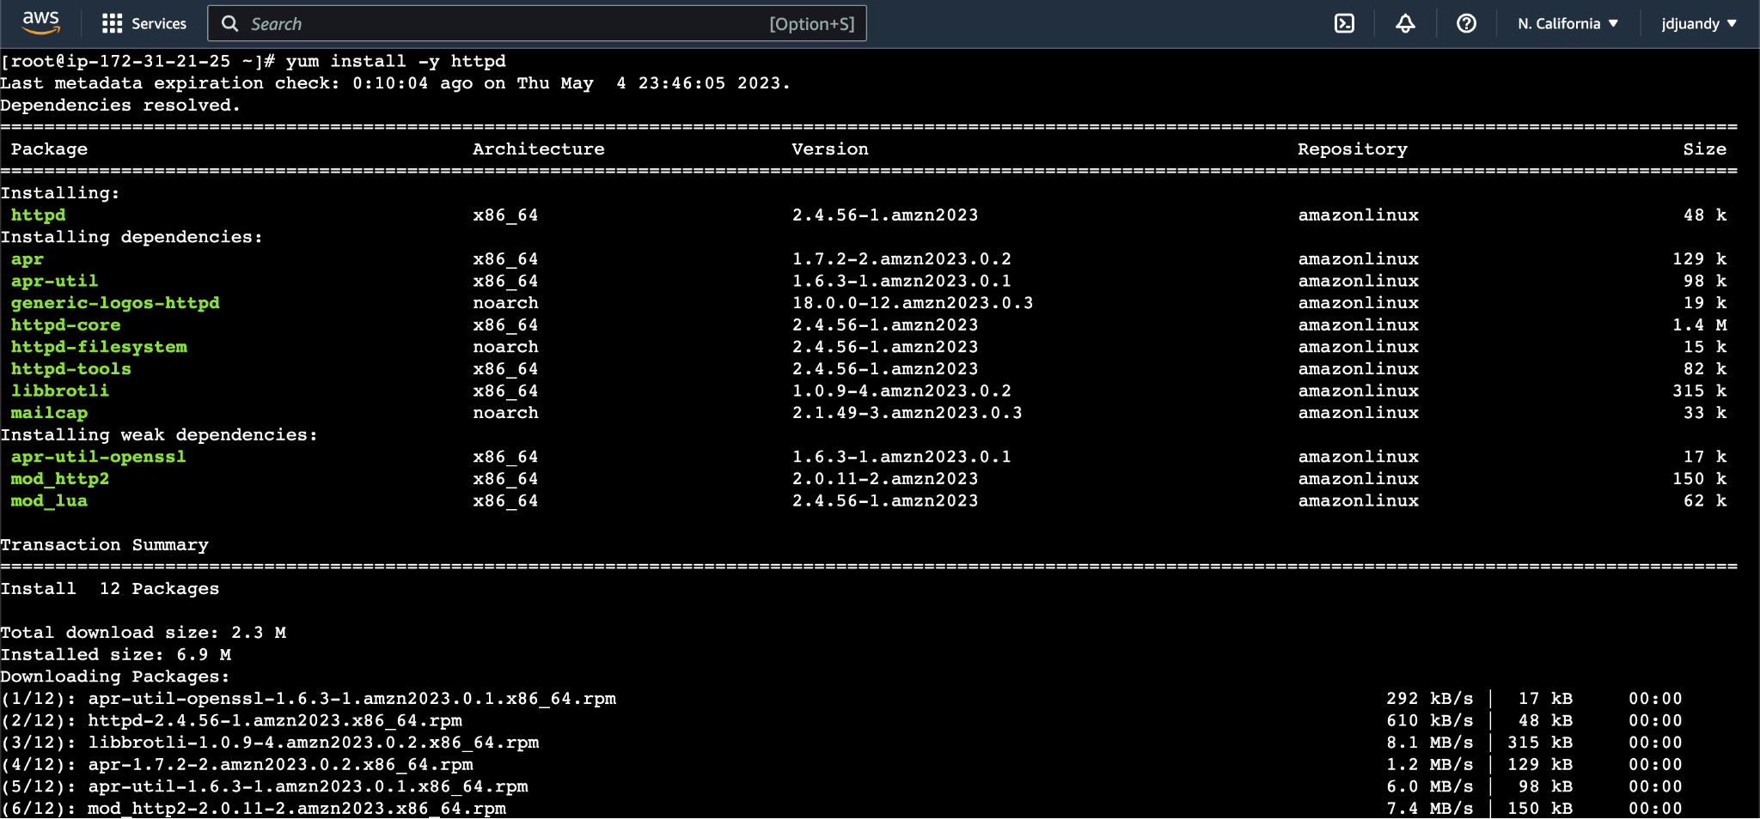

Slide 24
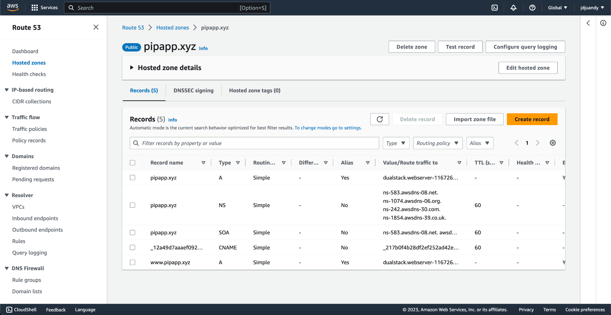
Domain with SSL

Slide 25
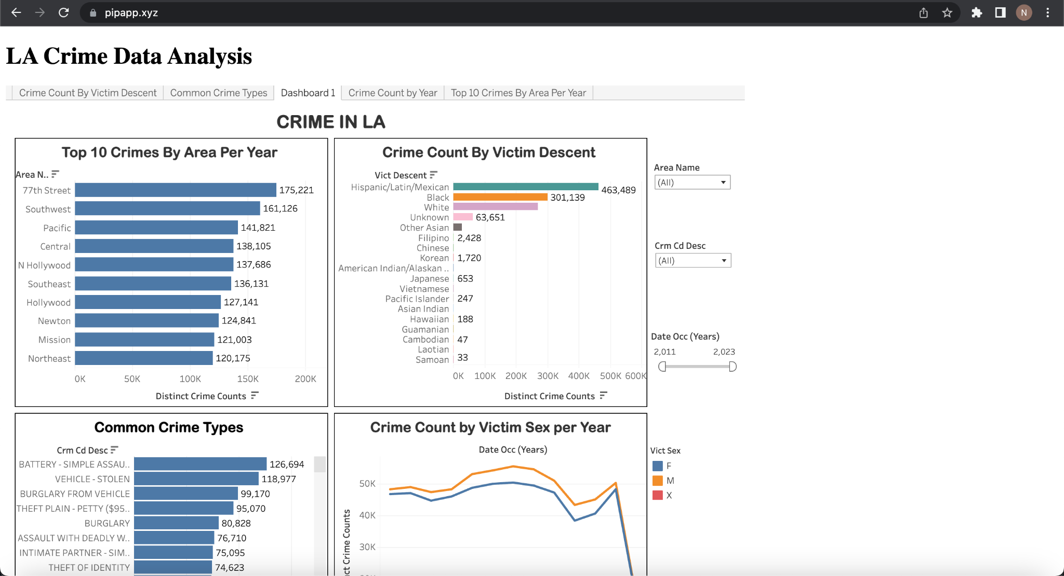
Data Visualization

Slide 26
Project Summary
Crime data in Los Angeles from 2010 to 2023 was obtained from the Los Angeles Open Data portal. The data was combined and uploaded to an Amazon S3 bucket. An EMR cluster was created to provide the resources for ETL and analytical processing. Processing the data was done through a PySpark script and Amazon Glue, with the output being a parquet file. An EMR command line interface was utilized to create an external Hive table with a reference to the parquet files. Tableau established a EMR Hadoop Hive connection to hive external table to create the interactive dashboard, and the dashboard was published to Tableau public. An EC2 instance with Apache HTTP was created to host the web application. The web application was created using HTML and embedded the interactive dashboard made with Tableau. The domain “pipapp.xyz” was purchased and configured with AWS Route 53 Hosted Zone to publish the web application. It is our hope that our web application will aid regular citizens, law enforcement, and policymakers to be more aware of crimes that have occurred in the city of Los Angeles.

Slide 27
Future Work
We hope to add the following to our project in the future:
Single Sign-On:
We hope to use services like AWS Cognito to be able to provide authentication and sign-on access to our web application.
More interactive dashboards:
We hope to increase the number of interactive dashboards available on the web application to further increase the amount of insights that can be obtained.
Automation:
The data from the LAPD is updated weekly. We hope to automate the process of cleaning and appending the newest data to the dataset so that users can obtain insights on the latest data.
Querying:
We hope to add a backend to the web application to be able to query data directly from the AWS database. The queried data will be able to be displayed through a new interface on the web application where users can manually see which data that are displayed, providing another option for users to obtain insights in addition to the interactive dashboard.
Improved User Interface:
We hope to improve the code of the web application to provide a more user-friendly and modernized look.

Slide 28
Thank you!

